Slide 1

PROJECT

Slide 2
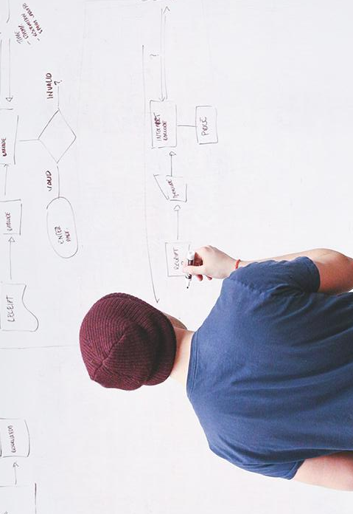
HELLO!

Slide 3
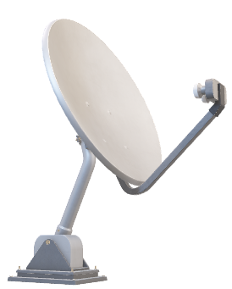
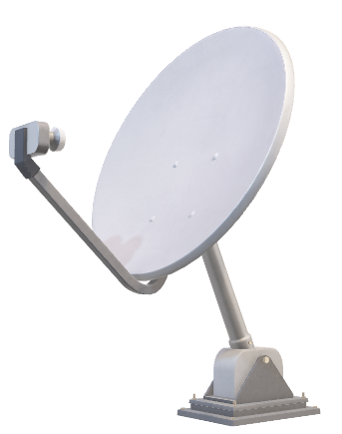
Worldwide Internet Users As % of Population

Slide 4
Agenda
Description
Content
Overview of DataSet
Coding
Output

Slide 5
DESCRIPTION

Slide 6
The dataset contains the individuals users of internet. Internet users are individuals who have used the Internet (from any location) in the last 3 months. The Internet can be used via a computer, mobile phone, personal digital assistant, games machine, digital TV etc.

Slide 7
CONTENT

Slide 8
1. Loading datsets
2. Preprocessing
3. Combining two datasets
4. Plotting the Internet usage of world

Slide 9
OVERVIEW OF DATASET

Slide 10
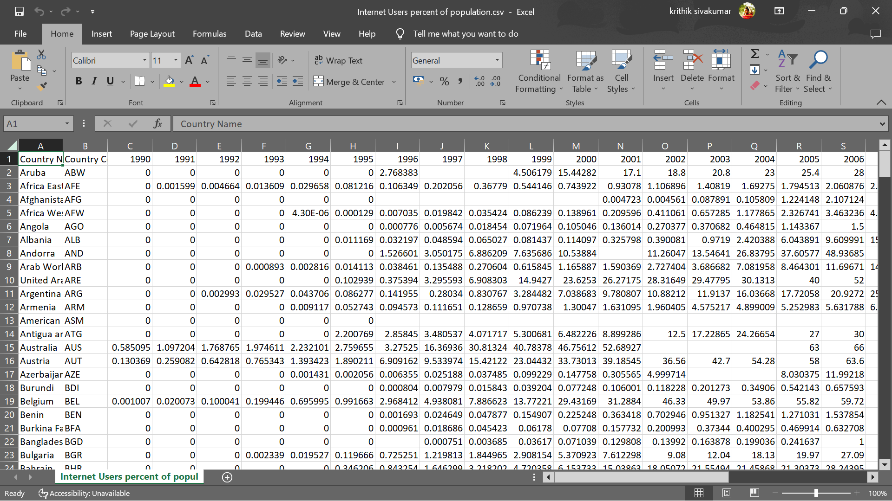

A picture is worth a thousand words
A complex idea can be conveyed with just a single still image, namely making it possible to absorb large amounts of data quickly.

Slide 11
CODING

Slide 12

Use charts to explain your ideas
White
Gray
Black

Slide 13
OUTPUT

Slide 14
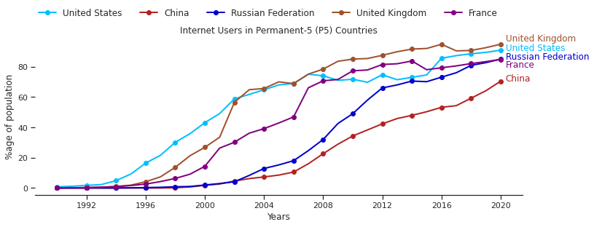
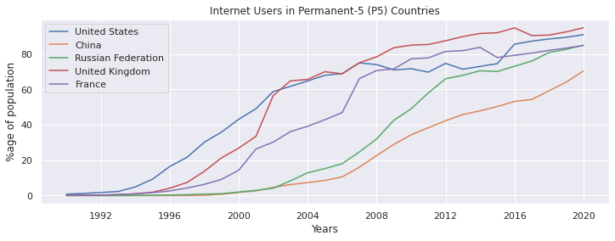

Slide 15
THANKS!
Any questions?

